Slide 1

Social
Buzz

Slide 2


Today's agenda
Project recap
Problem
The Analytics team
Process
Insights
Summary

Slide 3


Social Buzz is the largest growing technology unicorn that need to adapt quickly to its global scale.
Accenture has been focusing on the below mentioned tasks:
1. An audit of their big data practice
2. Recommendations for a successful IPO.
3. An analysis of their content categories that
highlights the top 5 categories with the largest
aggregate popularity
Project Recap

Slide 4

Problem
Due to their rapid growth and digital nature of their core product, Every day over 100,000 pieces of content are posted.
36,500,000 posts every year.
Analysis to find Social Buzz top 5 most popular content categories.

Slide 5



The Analytics team

Slide 6
Process
1
Data Understanding
2
Data Cleaning
3
Data Modelling
4
Data Analysis
5
Uncover insights

Slide 7
Reaction score for every category in each month
Count of Score | Months
Category | April-2021 | August-2020 | December-2020 | February-2021 | January-2021 | July-2020 | June-2020 | June-2021 | March-2021 | May-2021 | November-2020 | October-2020 | September-2020 | Grand Total
Animals | 136 | 141 | 139 | 147 | 141 | 137 | 69 | 79 | 153 | 171 | 142 | 159 | 124 | 1738
cooking | 124 | 141 | 136 | 109 | 142 | 134 | 55 | 58 | 118 | 144 | 114 | 133 | 117 | 1525
culture | 123 | 134 | 131 | 126 | 123 | 128 | 64 | 70 | 108 | 131 | 131 | 147 | 122 | 1538
dogs | 98 | 99 | 99 | 97 | 105 | 109 | 53 | 63 | 94 | 96 | 109 | 97 | 108 | 1227
education | 92 | 102 | 104 | 103 | 120 | 105 | 45 | 72 | 124 | 113 | 128 | 94 | 109 | 1311
fitness | 85 | 128 | 111 | 97 | 110 | 96 | 53 | 60 | 106 | 105 | 132 | 103 | 98 | 1284
food | 114 | 132 | 150 | 101 | 136 | 126 | 52 | 82 | 143 | 132 | 114 | 139 | 135 | 1556
healthy eating | 136 | 137 | 116 | 139 | 152 | 146 | 48 | 66 | 113 | 117 | 130 | 141 | 131 | 1572
public speaking | 79 | 111 | 92 | 85 | 90 | 106 | 39 | 47 | 78 | 100 | 96 | 98 | 95 | 1116
science | 144 | 130 | 144 | 115 | 159 | 145 | 60 | 76 | 118 | 143 | 150 | 130 | 132 | 1646
soccer | 121 | 109 | 112 | 99 | 109 | 106 | 47 | 61 | 123 | 118 | 103 | 115 | 116 | 1339
Studying | 95 | 96 | 115 | 107 | 104 | 101 | 34 | 51 | 134 | 109 | 107 | 90 | 108 | 1251
technology | 120 | 153 | 158 | 123 | 127 | 137 | 49 | 72 | 130 | 128 | 109 | 125 | 126 | 1557
tennis | 88 | 110 | 104 | 105 | 105 | 116 | 51 | 48 | 101 | 96 | 85 | 99 | 110 | 1218
travel | 129 | 129 | 137 | 110 | 129 | 114 | 52 | 79 | 127 | 134 | 113 | 120 | 137 | 1510
veganism | 109 | 94 | 86 | 88 | 104 | 95 | 46 | 49 | 87 | 95 | 92 | 99 | 102 | 1146
Grand Total | 1793 | 1946 | 1934 | 1751 | 1956 | 1901 | 817 | 1033 | 1857 | 1932 | 1855 | 1889 | 1870 | 22534

Slide 8

Insights
From previous table we get the insight that
16
Unique
Categories
1738
Reactions to
Animal posts
January
Month with the most post

Slide 9
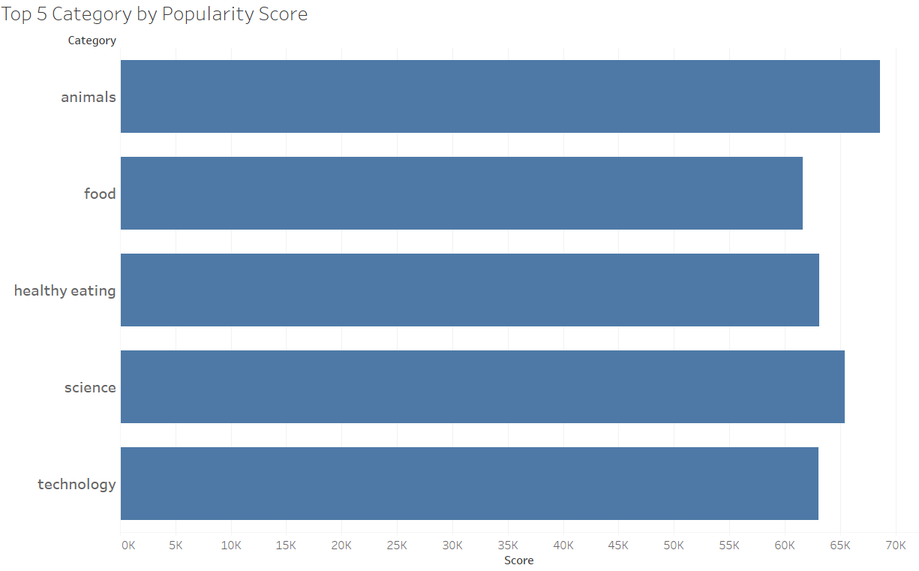

Slide 10
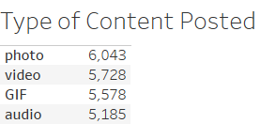
Count of Sentiment broken down by Content type

Slide 11

Analysis
Animals and Science are the two most popular categories of content, showing that people enjoy “factual” and “real life “ content the most.
Photos are the type of content that are posted the most
Summary
Insight
Food is a common theme in the top 5 categories with “Healthy Eating” ranking the highest.
You could use this insight to create a campaign and work with healthy brands to boost your engagement.

Slide 12
Thank you!
ANY QUESTIONS?

